Slide 1


















OpenDRR Platform
RiskProfiler
CGP
Open Data
F/P/T Portals
Provide tools to facilitate decision making prior to and during a crisis
Emergency Theme
Key Components
OpenQuake Engine
GitHub Data Repository
Federal Geospatial Platform (FGP)
Public Portal (RiskProfiler.ca)
Kibana
FGP
CSW
Elasticsearch
FGP GCC
OGC
Esri REST
WPS (CZS)
PostGIS
Risk Analyst
Emergency Planner, Risk Manager
GitHub pages
GC User
OpenQuake Engine
OpenDRR GitHub
Public

Slide 2
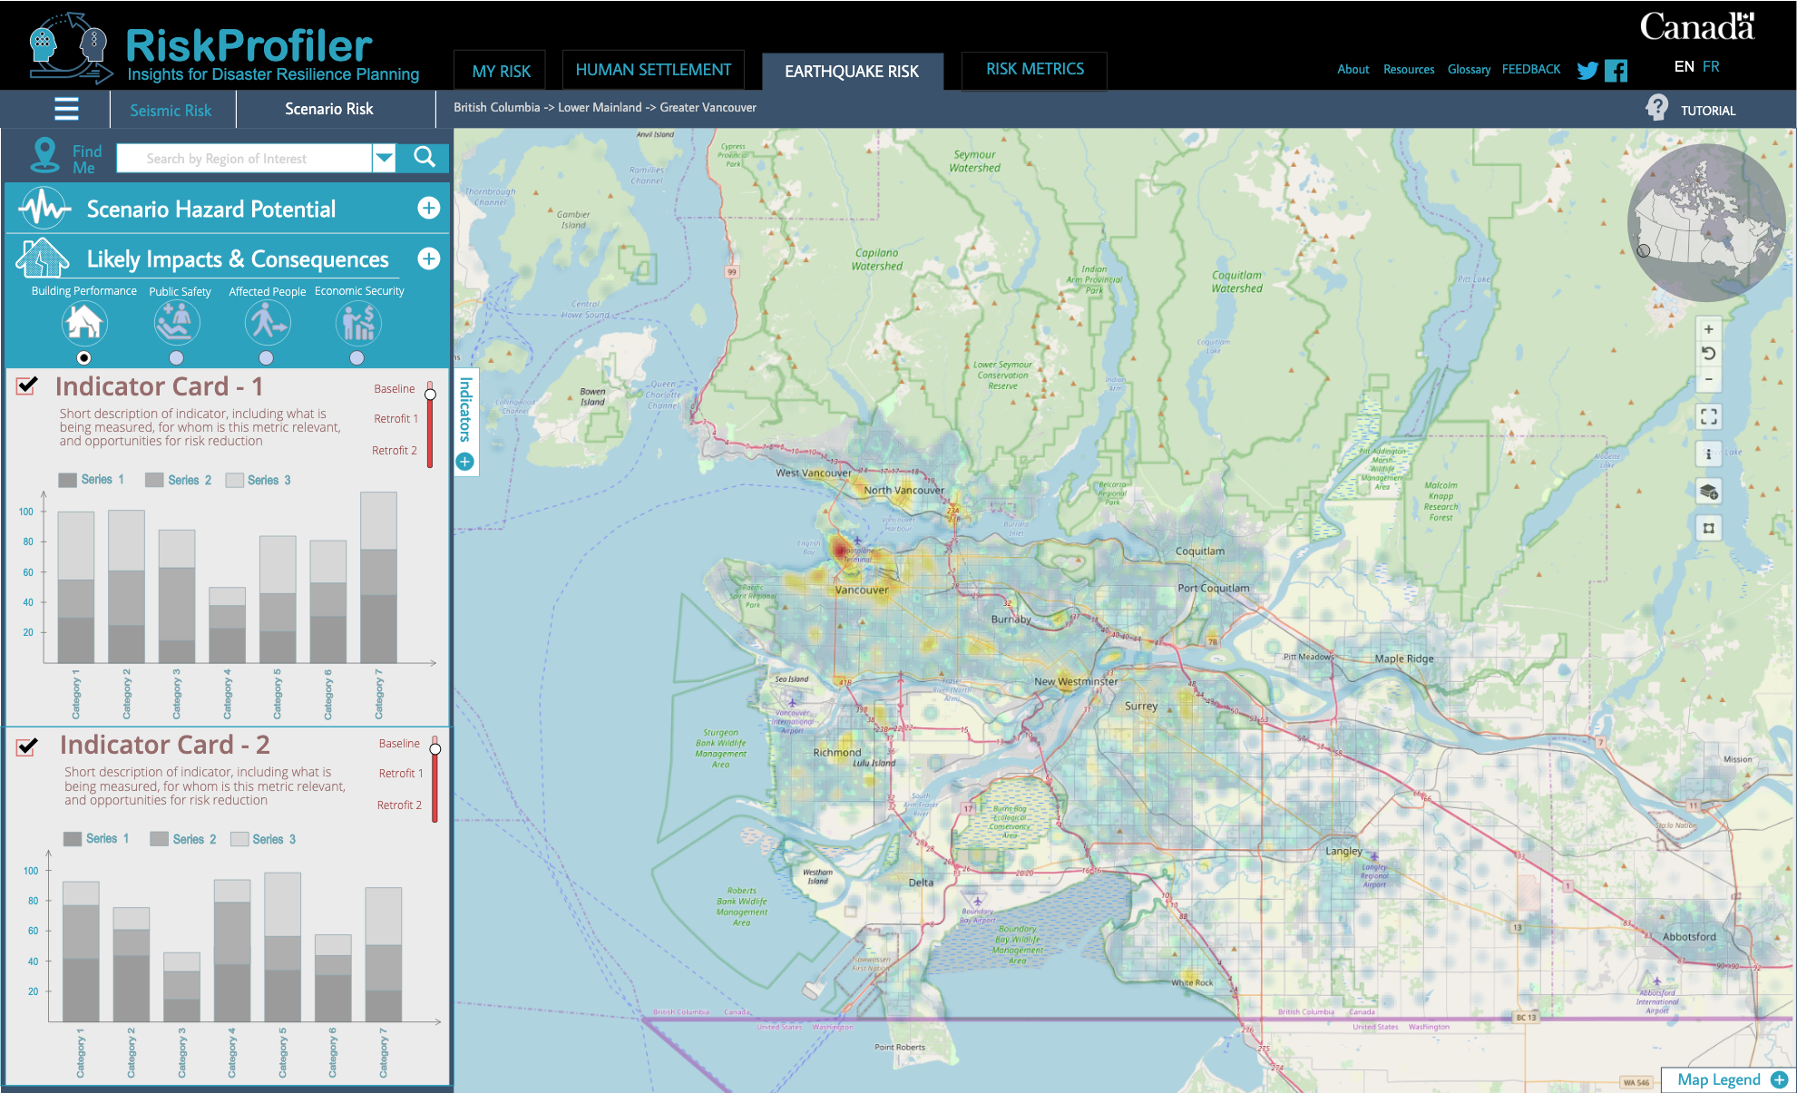
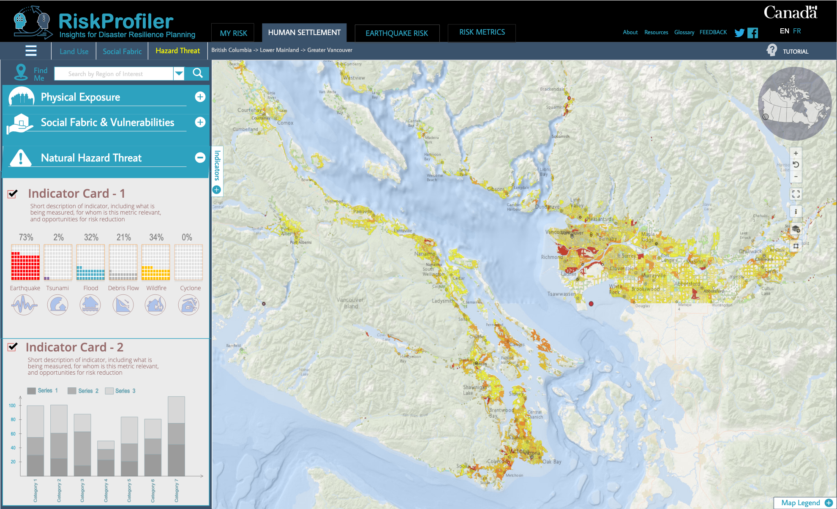
RiskProfiler.ca
Purpose-built web application for non-experts
High-level overview of hazard risk
Interactive maps and graphic visualizations with supporting text
Contact points for more information about hazard risk

Slide 3
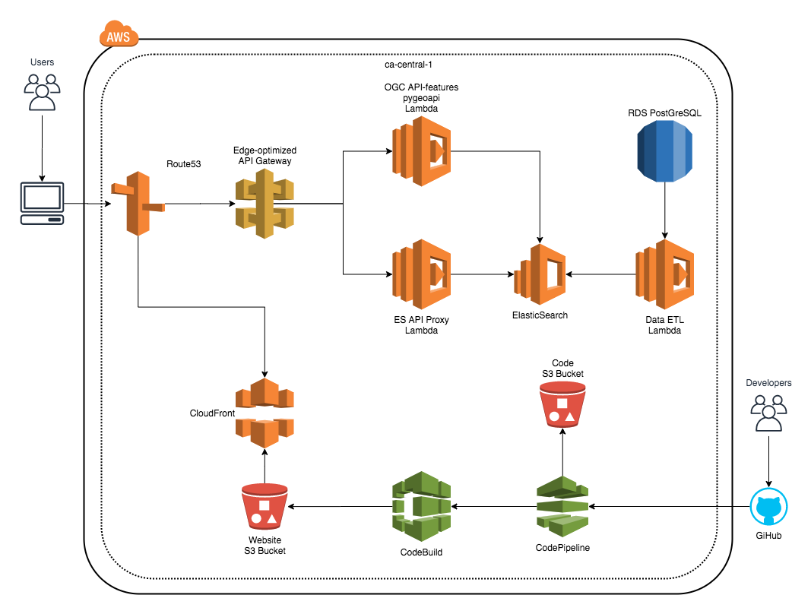
RiskProfiler Cloud Deployment

